Slide 1

Mt. Union UHF Repeater
2016 Upgrade Project
YARC Repeater Committee
Pete K6VVR – Trustee of W7YRC
John K7PRS – Experienced Repeater Wizard
Doug NO1D – Mt. Goat/presenter
With help from
YARC ARES/RACES Team Members
Bud N7CW, Art KG6AY, Rob KG7LMI

Slide 2
Tonight’s Agenda
Background on UHF 447.65/442.65 Repeater
2016 Upgrade Plan
Eq. Donations/Procurement and Refurbishing
Photo’s Spring Mt. Union Site Survey
Photo’s 2^{nd/3rd} Trip Antenna / Duplexer upgrade
Moving repeater into ARES/RACES Hut
Enabling C4FM Digital Mode
Futures

Slide 3
Background
UHF 442.65/447.65
Tx Tone: 100.0
Analog Only
Operated on Mt. Union
~ 8000ft elevation
Fusion DR1x Repeater
Mot T1500 Duplexer
~ 20W Power
Comet CG6 Vertical
Coverage was sub-optimal
Improvement request Jan 16 meeting; Prescott Junction
Possible Issues:
Duplexer
Low Power from DR1
Antenna
Left with basic plan & list of options & research tasks
Plenty to do while we await spring access to Mtn.

Slide 4
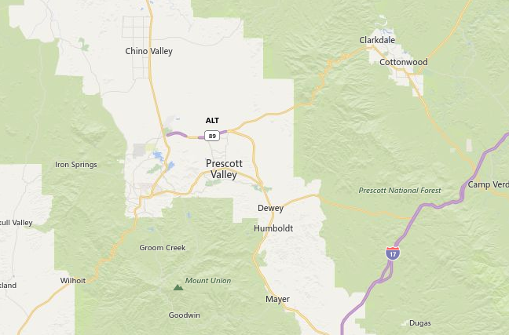
Mt Union

Slide 5
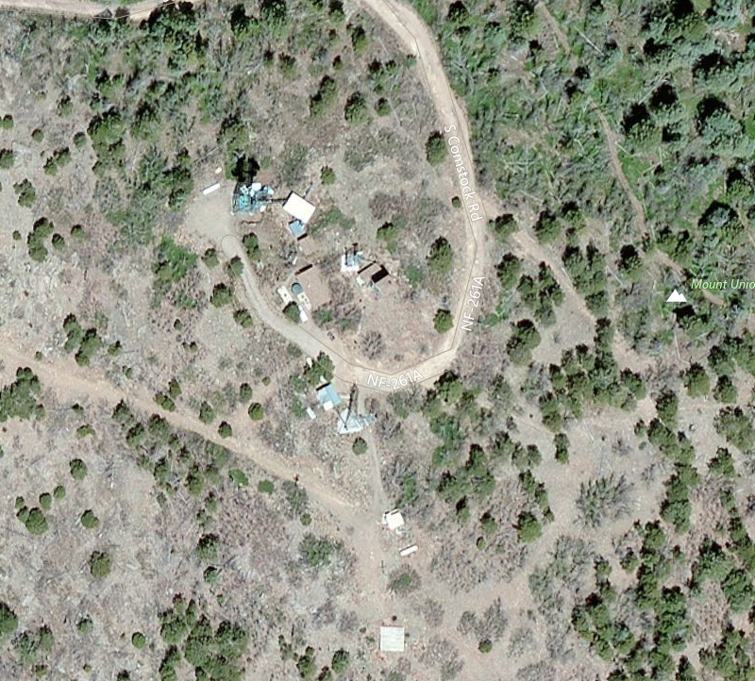

Slide 6
Yaesu Fusion DR1X Repeater
Club purchased (2) units on special program to clubs by Yaesu
Supports FM Analog and new C4FM digital Modes
2m & 70cm capable
Basically (2) mobile FT400DR’s in single chassis
UHF high power spec’d at 50% duty cycle; 50W
Infancy failures by ops running high power
Desire to run at low power to improve longevity

Slide 7
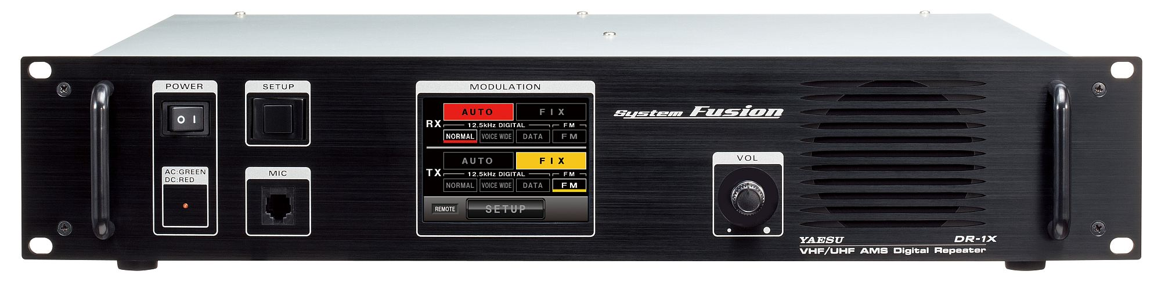
Yaesu DR1X
2U sized chassis
Touch Screen control interface
Mic, Vol & Speaker
115VAC and 12Vdc power
Built in repeater controller; minimalistic

Slide 8
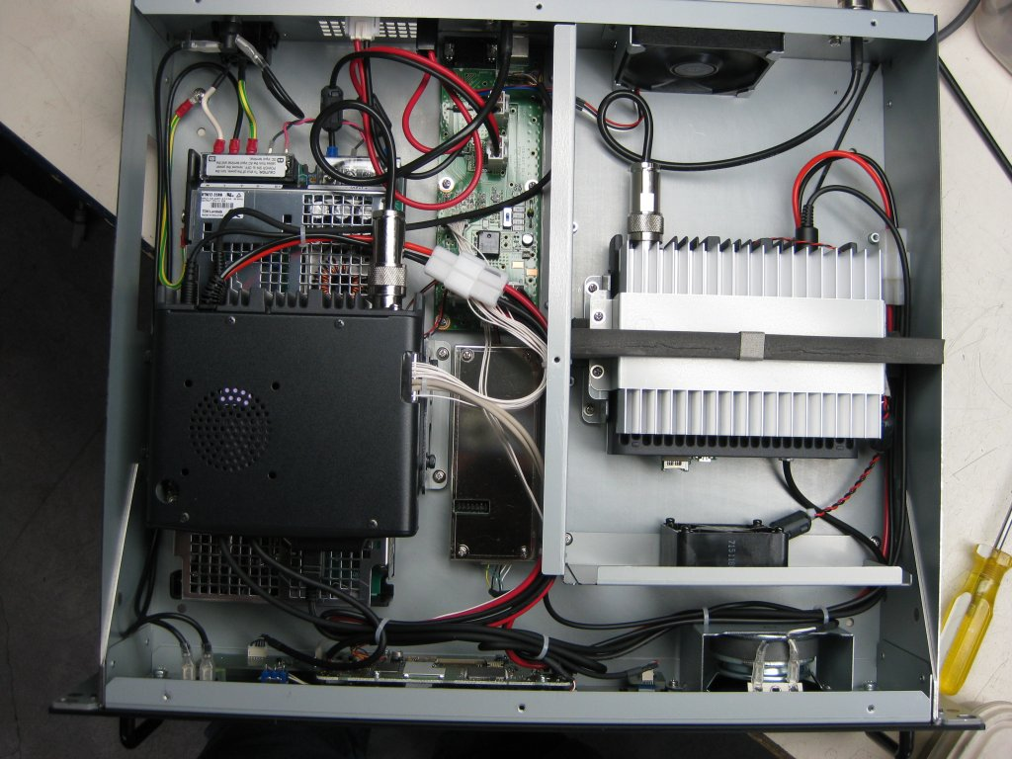
Inside the DR1X

Slide 9
Equipment Donations / K7PRS
Motorola MSR 2000 Amplifier
Micro/Mitrek UHF for Amplifier Spares
20W UHF Amplifier and Fans
Notch Filters – 25dBm ea.
Decibel Products 4076W Duplexer
Feed lines, Hard line Connectors, UHF Cable
Club also purchased several items, Isolator, LPF, Cables, Lightning Arrestors, loads, feed line and antenna
23” to 19” adapter brackets, Rig Runner, 100W load, 7/8” connectors, Z-Match, Attenuators, Rack Panels, Volt/Amp Meter, Shunt, SSR, 12v cables
In Addition

Slide 10
Upgrade Plan
Configure DR1x to run low power 5W
Add commercial grade external amplifier capable of 100W
Look into changing antenna; ideally 4 bay UHF folded dipole @ 9dBi gain or better
Prepare spare UHF duplexer to swap out existing
Build up spares list to keep this equipment running
ARES/RACES team offered to house UHF repeater in S. Hut on the Mtn. Helping reduce monthly club operational costs
New hut offers (AWESOME) battery backup supply
Planned to perform site survey as soon as weather cleared in Spring

Slide 11
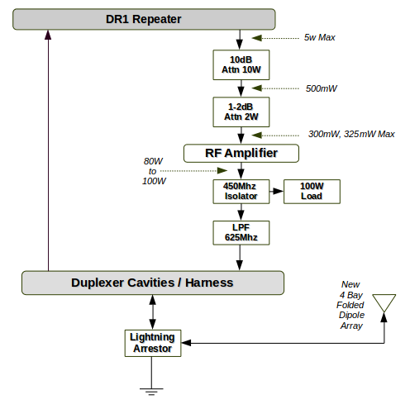
RF Block Diagram

Slide 12
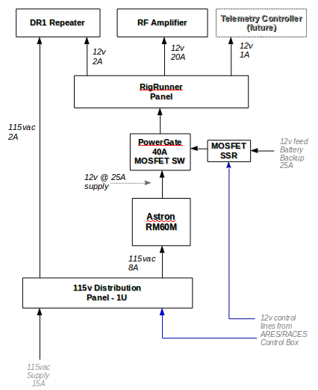
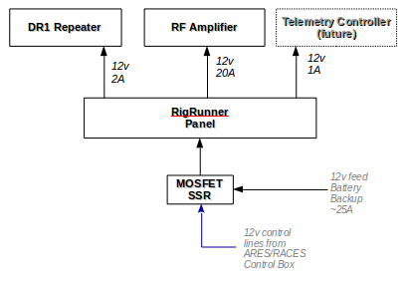
Power Supply
DC configuration option

Slide 13
Amplifier Refurbishment
Before snow melted started work on MSR2000 amplifier
Was in good shape; 40W of power but not up to spec
Had some custom options & bypassed RF control board
So stripped it down
Removed customizations
Repaired RF control board
Added 9.5vdc supply
Added external 12v Fan
New Power cables
Bench test

Slide 14
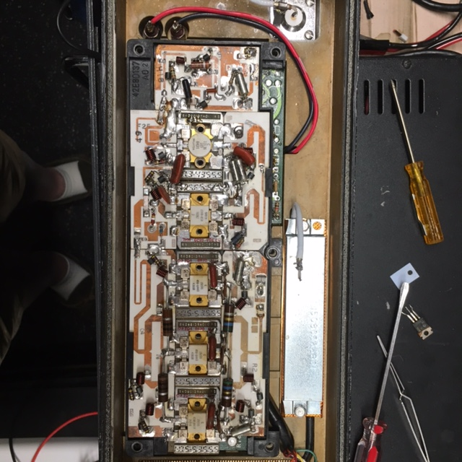
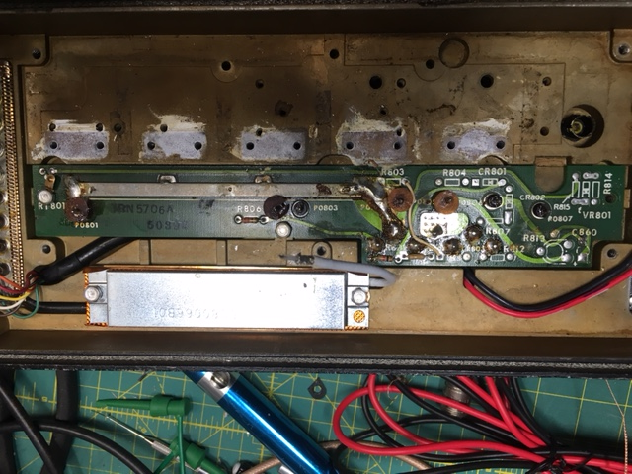
MSR2000 Refurbishing

Slide 15
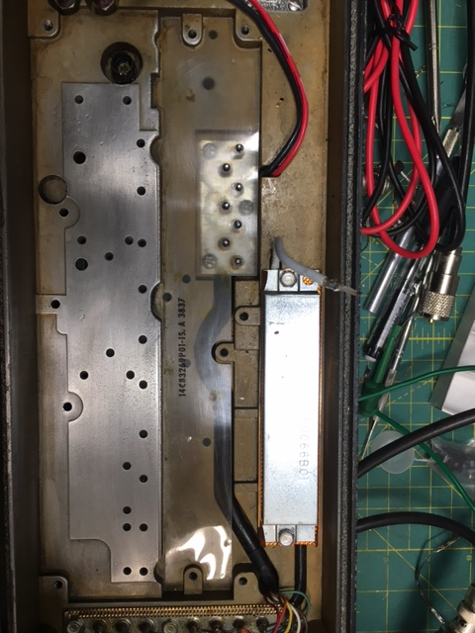
Cleaning up heat sink

Slide 16
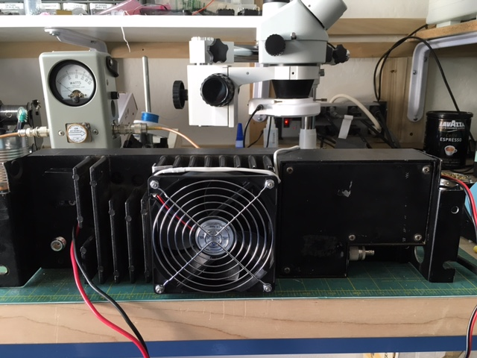
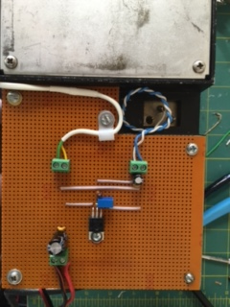
End Result

Slide 17
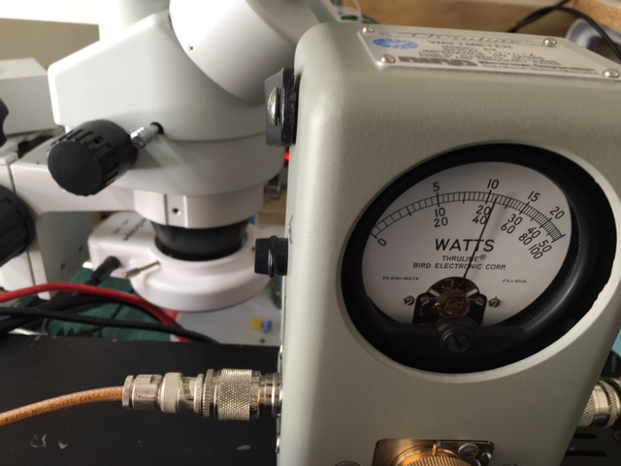
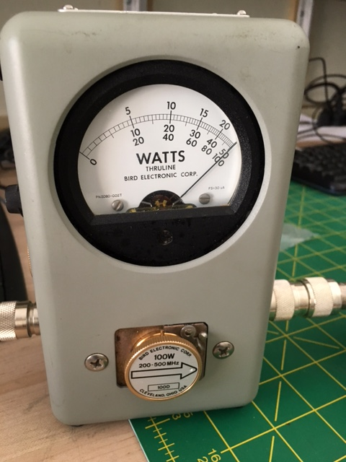
Before ~ 42W
After Solid 100W

Slide 18
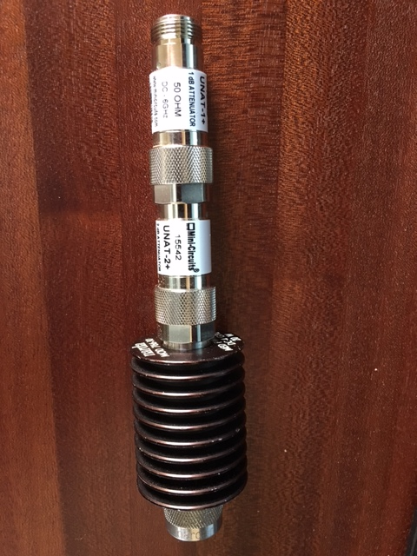
Fusion Low Power Drive
5w output from DR1X too high for MSR2000
Opted to use In-Line attenuators
Vs modification of Amp
Calculated 14dB atten to get necessary 345mW power into Amplifier
10dB → 3dB → 1dB

Slide 19
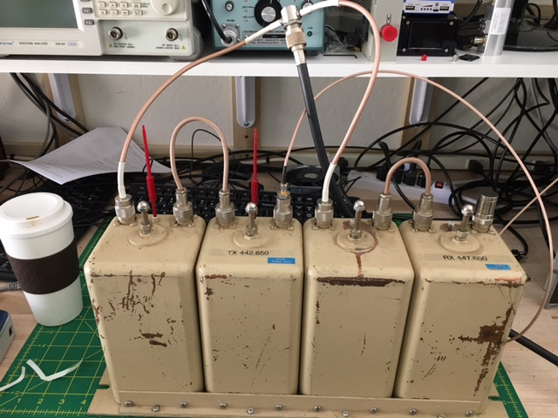
Next Up, Duplexer
Key to a repeaters performance
Isolates Tx from Rx
Poor isolation results in desense
Or worse, Rx damage
100dB isolation goal
Performance can drift due to temperature extremes
Good to check 1-2 times/yr
Combination BPF and Notch

Slide 20
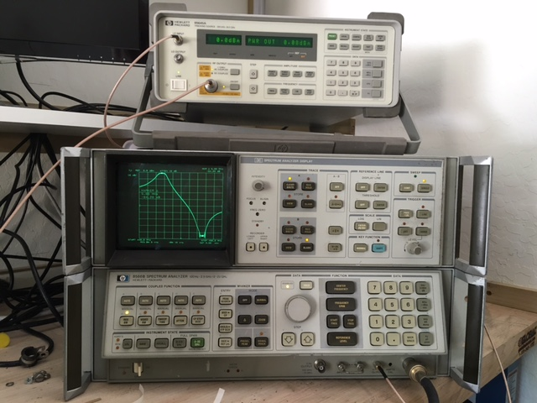
Tuning Test Equipment
HP 16475 Tracking Generator
HP8566b Spectrum Analyzer
Sweeping 440Mhz to 450Mhz
10dB/div, 3Khz BW
Tune & Tweak

Slide 21
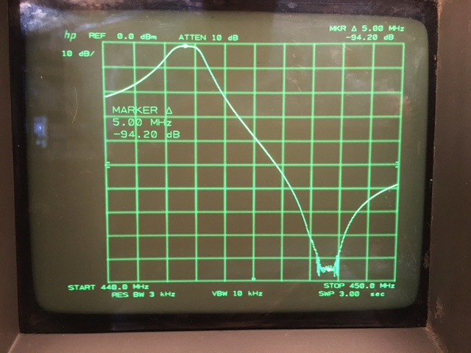
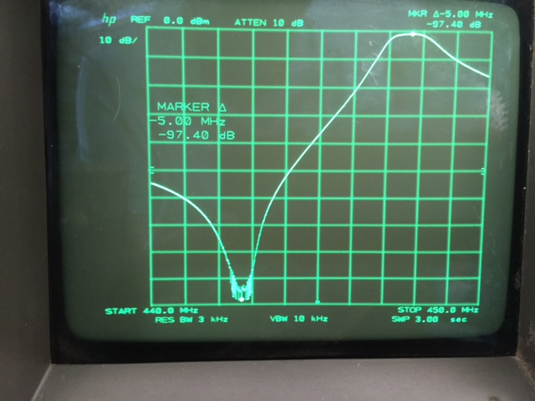
Tune for Max Tx / Rx Isolation & Minimal Insertion Loss
Rx Pass, Tx Notch
Rx Notch, Tx Pass

Slide 22
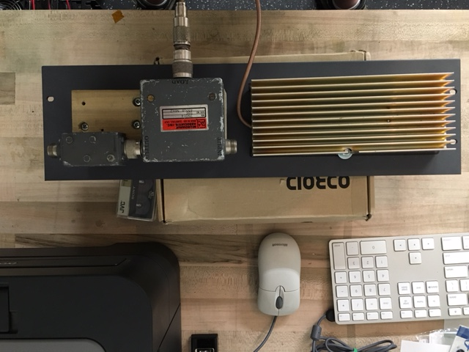
Isolator, LPF and Load
Isolator is 3-Port device; input, output, load
Redirects RF power from Amplifier into Load on any VSWR
Non-Linear Device
LPF needed due to harmonics generated
Protects Amplifier
Isolator is Ferrous/Magnetic so mounting panel should by non-ferrous
LPF -3dB @ ~500Mhz

Slide 23
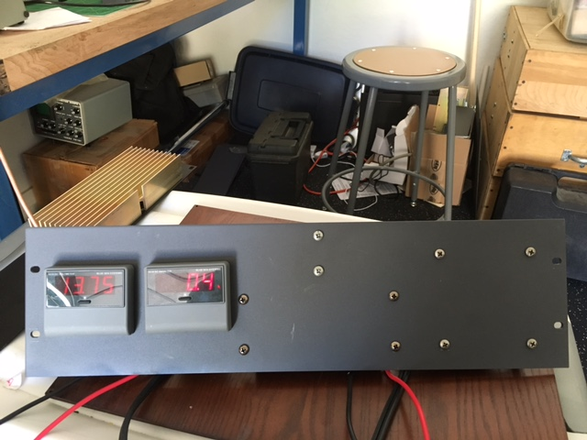
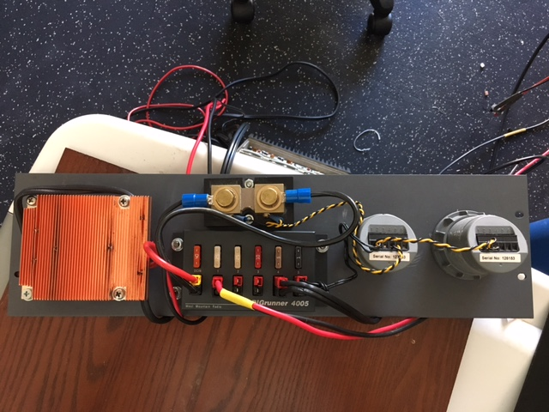
Power Panel

Slide 24
Site Survey
Spring 2016 trip to Mt Union

Slide 25
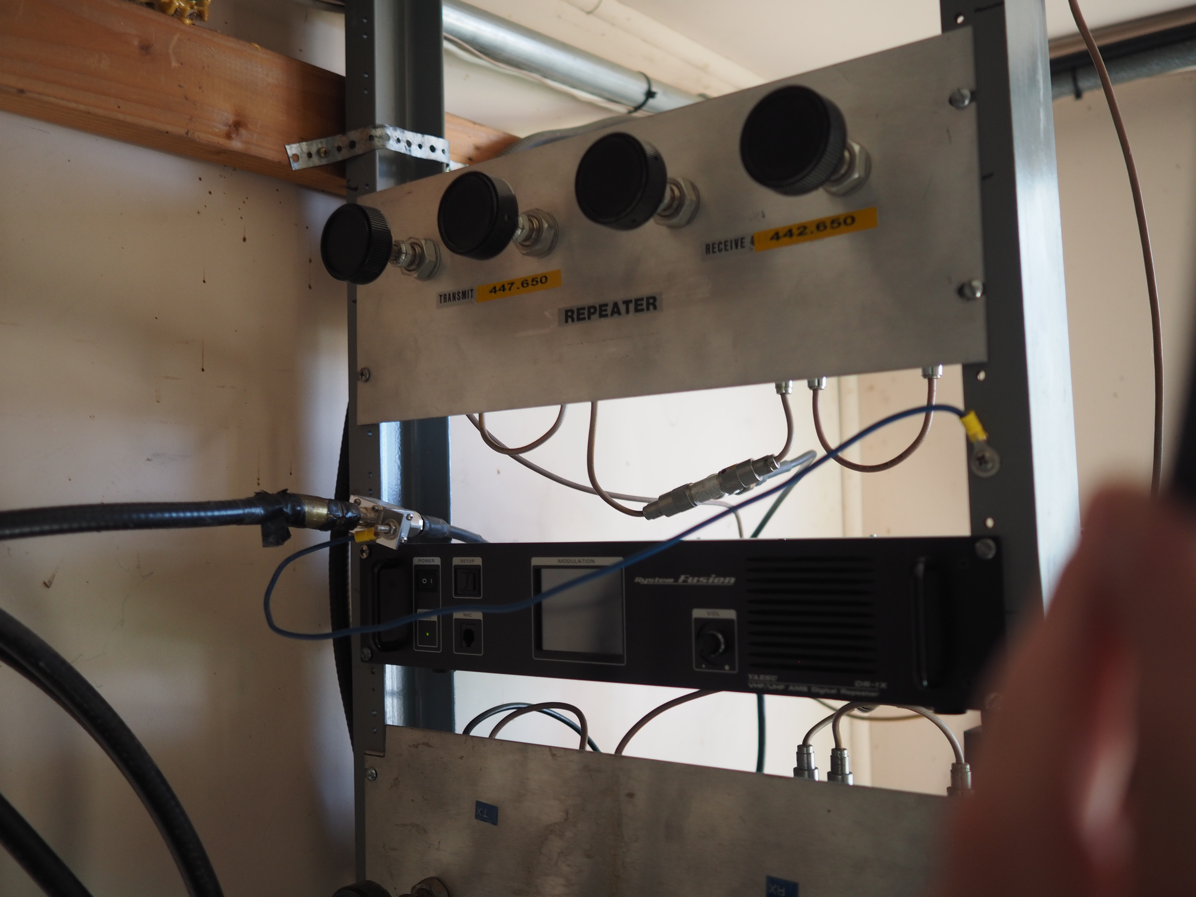

Slide 26
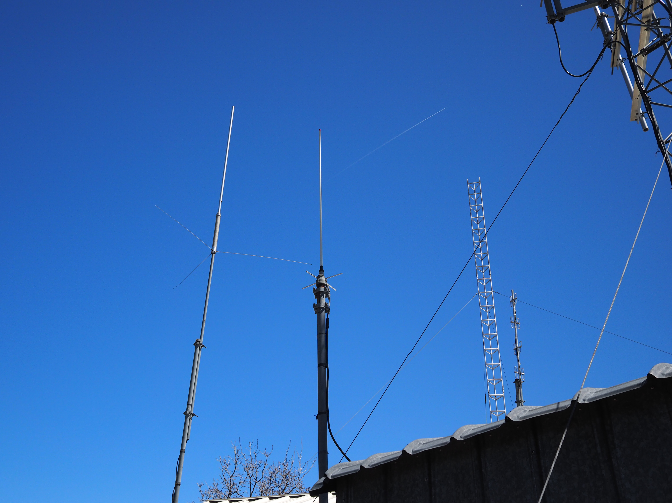

Slide 27
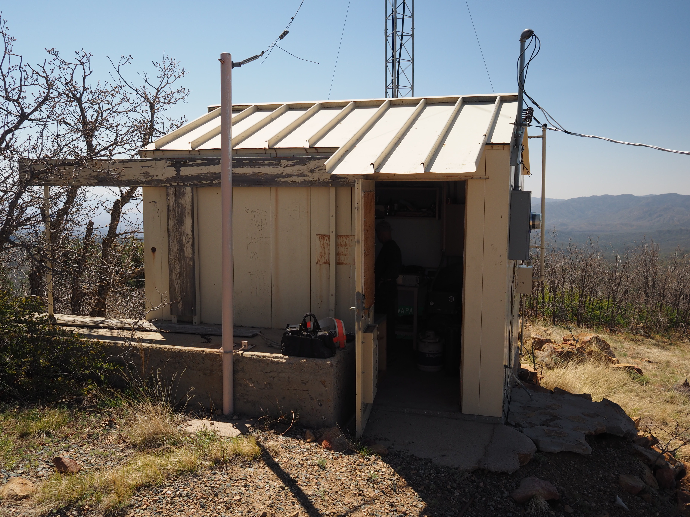

Slide 28
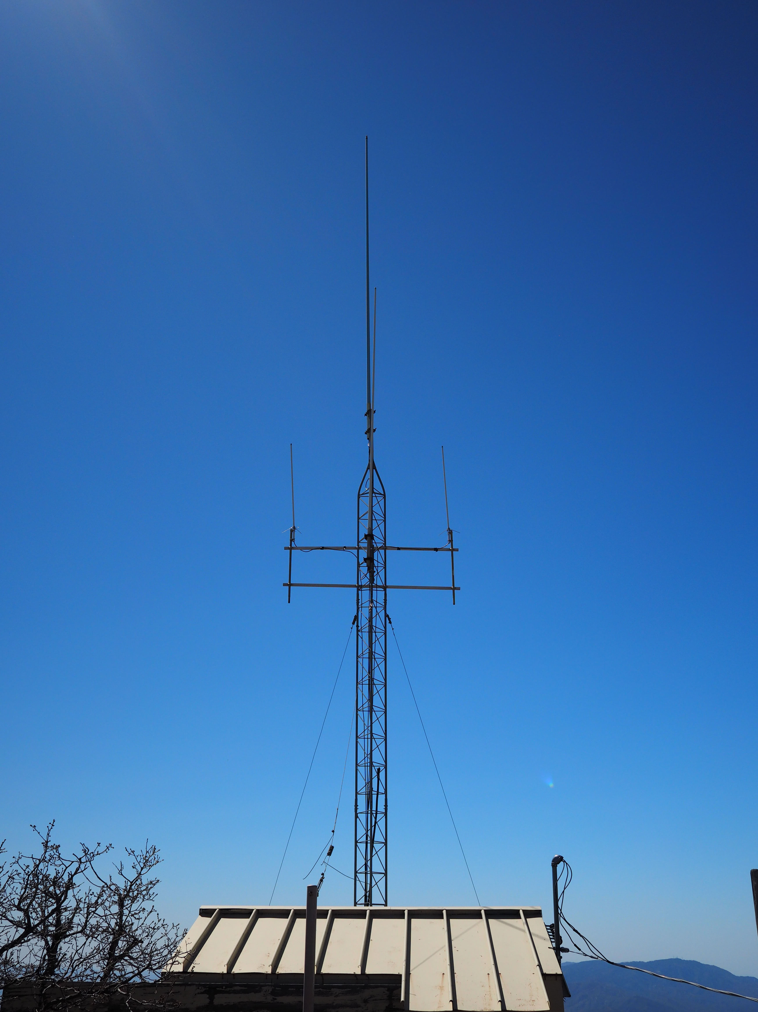

Slide 29
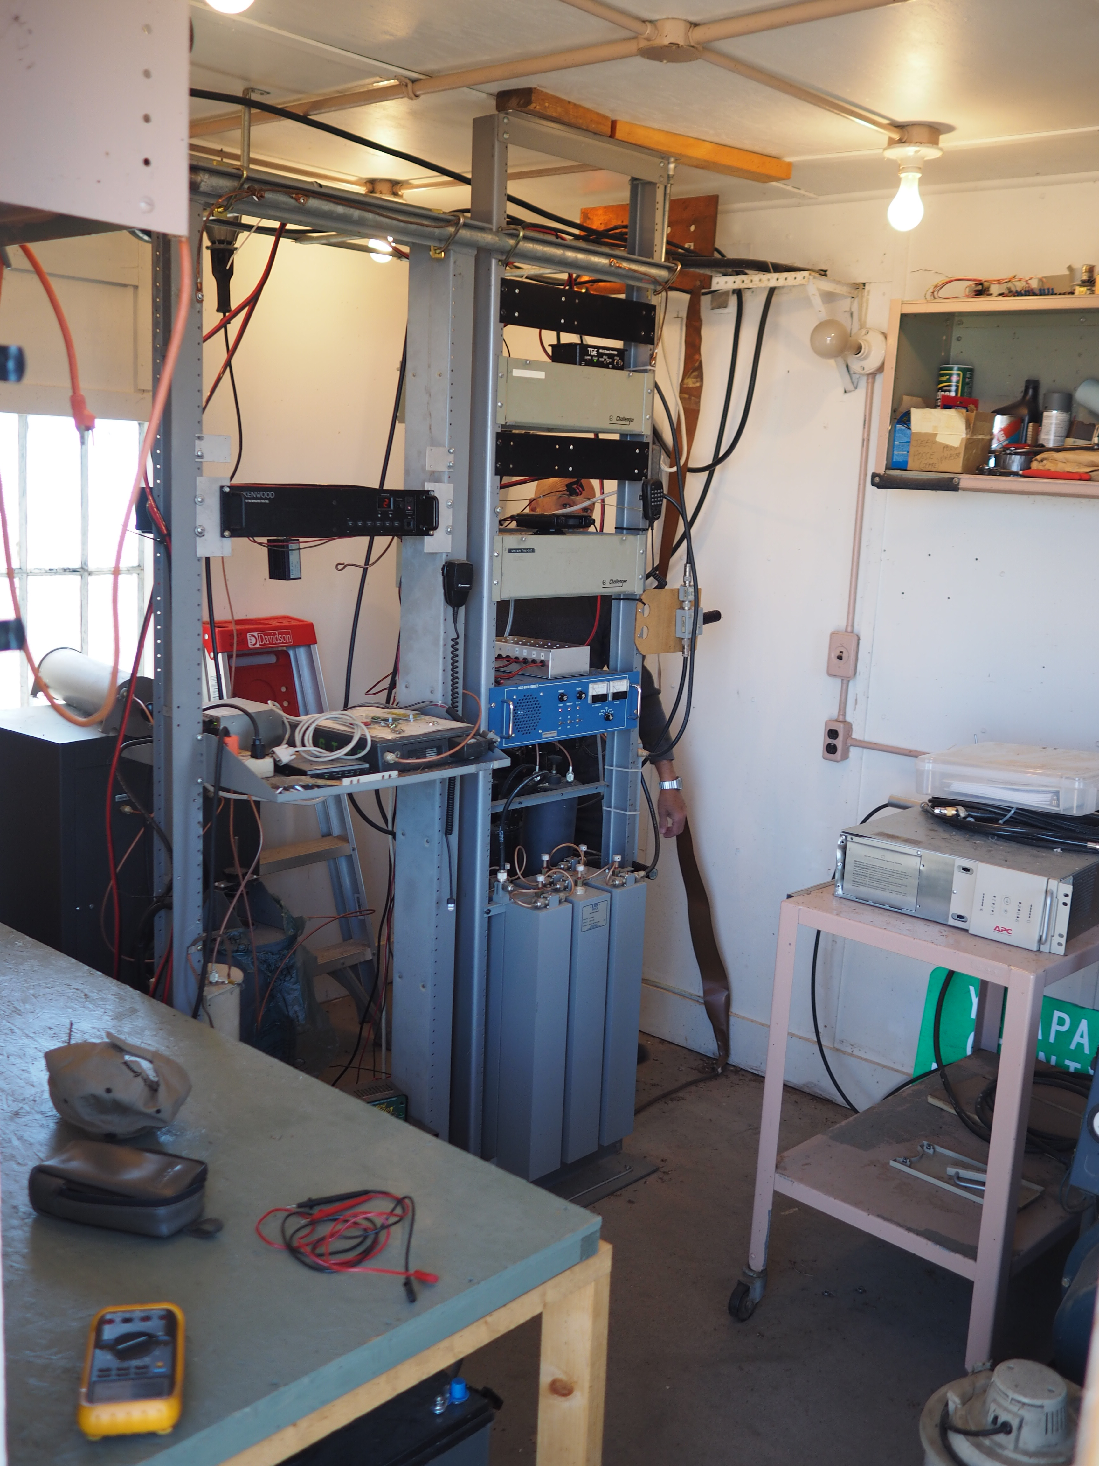

Slide 30
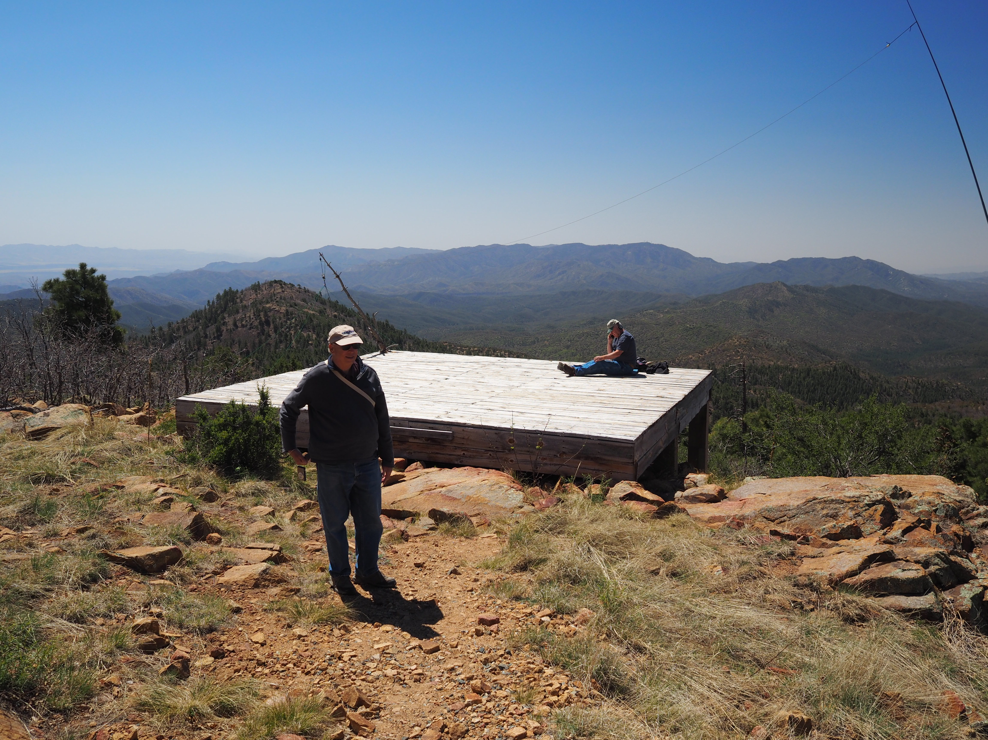

Slide 31


Slide 32
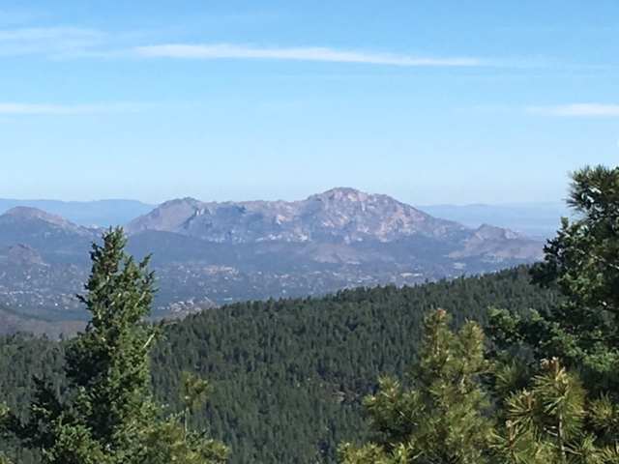

Slide 33
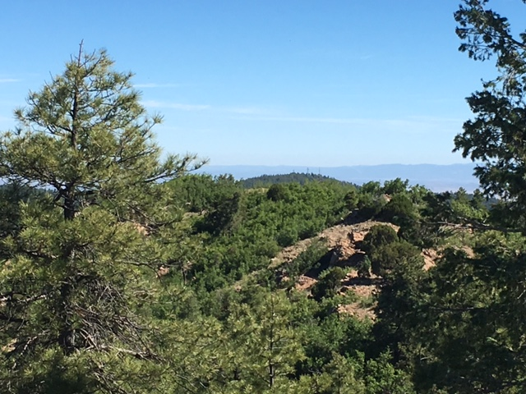

Slide 34
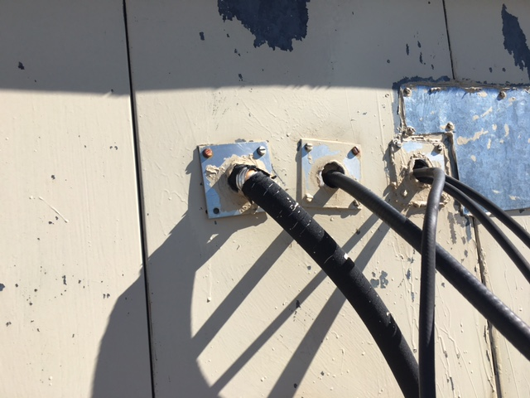

Slide 35
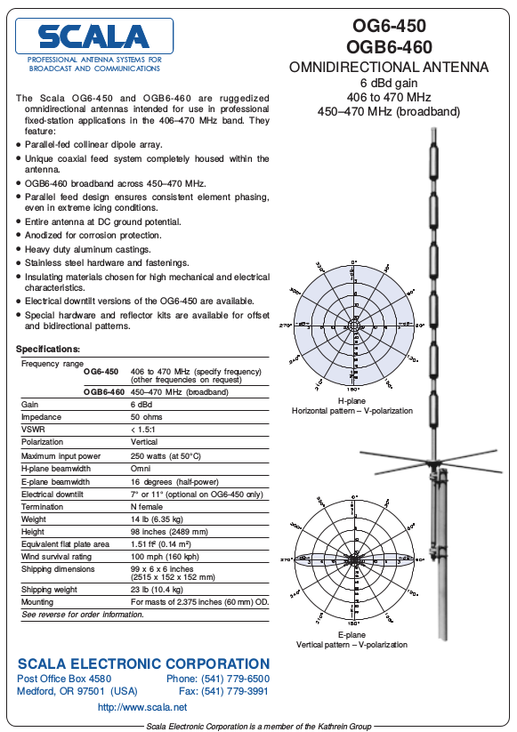
Feed line and Scala Antenna
N2THD Chuck had some goodies for the club
50ft 7/8” feed line
Several interesting UHF antennas
Scala Omni Vertical
Thanks to Mike K7QDX for Scala contact and data sheet !

Slide 36
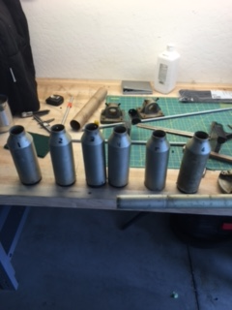
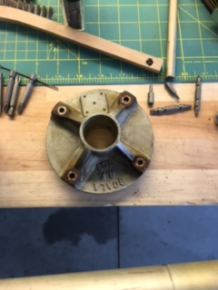
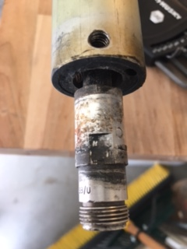
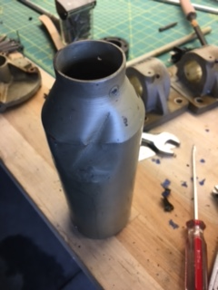
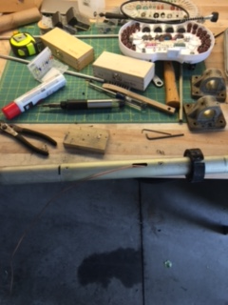
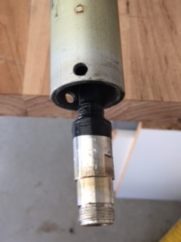

Slide 37
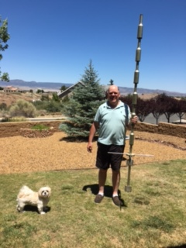
Scala Antenna
Brought home and began to strip it down
6 “cans” which act as folded dipole (or hairpin match)
Removed dents best I could
Cleaned and repaired connections
Winterized/Sealed
New SS HW and 4 new radials

Slide 38
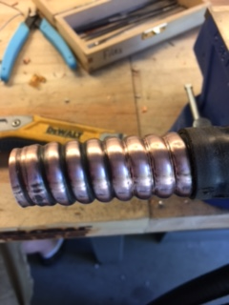
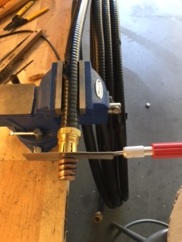
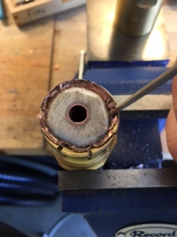
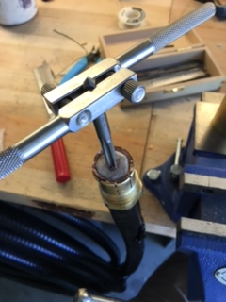
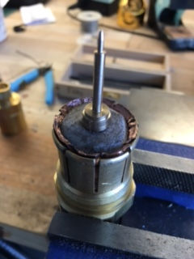
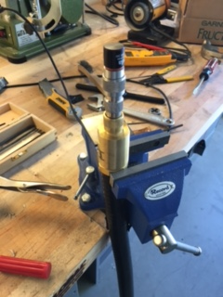

Slide 39
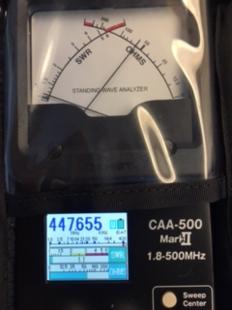
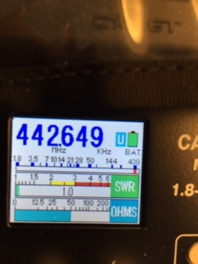

Slide 40
Install Scala, Replace Duplexer
Repeater was experiencing severe desense
Replaced Duplexer
Replaced Comet w/ Scala
Took Several VSWR and Power Measurements
Tuned radials, Replaced/Tuned Tx → Duplexer cable
Increased from ~15W to 20W
Results promising, much better coverage and overall improvement from upgrades during this trip
Took opportunity to install several new components into ARES/RACES Hut

Slide 41
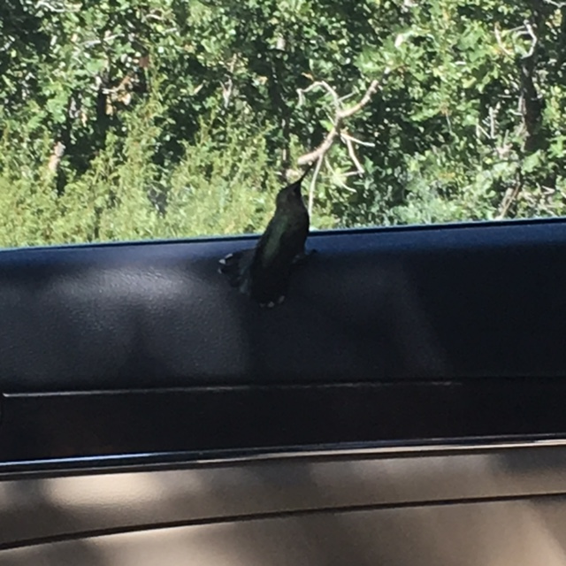

Slide 42
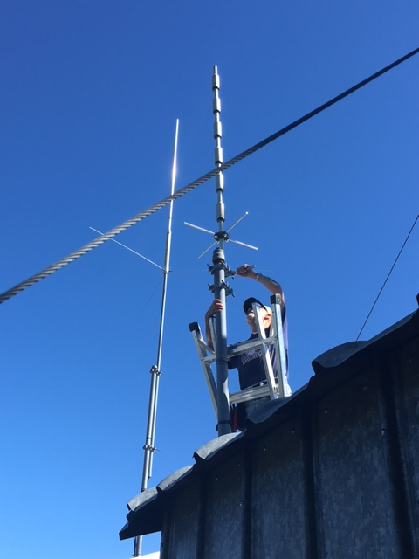
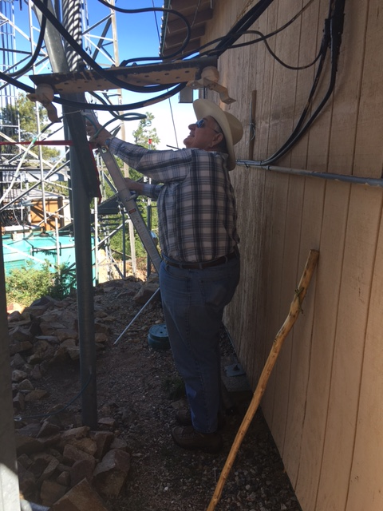

Slide 43



Slide 44


Root Cause Found T1500 Duplexer Bench Scan

Slide 45


Improvement

Slide 46
Moving into ARES/RACES Hut
Would like to do this ASAP
Antenna Mounting bracket being made
Big job, need WX to cooperate & plan to be safe
Team to meet prior to review tasks/duties
Will need UHF capable stations to be available afternoon of installation for signal reports
Run new feed line up tower
Move/mount Scala on tower
Secure feed line into hut
Move repeater and Duplexer
Connect to power supply
Verify power controller
RF Interconnects and Lightning arrestor
Measure performance
Enable C4FM AMS mode

Slide 47
Let’s Talk C4FM Digital
Continuous 4level Frequency Modulation
A type of 4 level FSK
Similar to Phase 1 P25 (not compatible)
Automatic Mode Selection (AMS)
FM Analog Fixed mode
(current config)
AMS Rx, FM Tx
FM Analog to FM Analog
C4FM Digital to FM Analog (no digital info transfer)
AMS Rx, AMS Tx
FM Analog to FM Analog
C4FM Digital to C4FM Digital
Out of the Box, C4FM is not compatible w/ D-Star or other Digital modes
w/ hardware and internet we can interface with other systems
C4FM digital info; GPS, Callsign, images
C4FM provides high quality audio w/ error correcting
High quality audio or
Data transmission mode
Images via C4FM with appropriate equipment.

Slide 48

AMS FM Tx Mode

Slide 49

AMS Tx Mode

Slide 50
W7YRC UHF Repeater Configuration
Full AMS mode enabled
C4FM ==> C4FM, digital to digital
FM Analog ==> FM Analog
FM Analog, looking for 100.0 PL on Receiver
FM Analog, sends 100.0 PL from Transmitter
There is no priority, digital vs analog

Slide 51
Analog FM Users
Remember to enable RX CTCSS T-SQL to prevent squelch opening during C4FM transmissions
RX T-SQL: 100.0 Hz PL same as TX
Failure to use RX T-SQL you will hear digital burst opening your squelch during digital coms
Continue to use TX CTCSS PL Tone 100.0 Hz
Double check S-Meter before TX as digital coms may be underway and your squelch will not be open

Slide 52
Yaesu Digital Users
Read up on capabilities of your rig; AMS Mode
DN mode: Digital Audio w/ error correction
VW mode: Digital Audio, Full 12.5Khz BW high qual
DW mode: High Speed Data coms, auto for video
FM mode: Analog FM mode, if your digital cuts out, fall back
AMS Auto Tx mode allows you to answer in mode last received
Useful when there’s analog users mixed in with digital users
You can override and force your Tx to only be sent digitally however leaving in Auto Tx mode will help include analog only users into coms/nets.
Experimentation to gain experience needed
Full C4FM mode should exchange GPS coords as well as call sign information.

Slide 53
Futures
Performance Mapping
Radio Model, SPLAT
Actual Field Measurements
Add Telemetry via embedded system based controller
D-Star / AllStar interfaces
Perhaps IRLP if there is desire.
Wires-X to C4FM
Dependent upon Internet Access to Mt.
High Speed Mesh Network?
Maintenance Visits
Antenna, Power and Duplexer checking
Build inventory of VHF / UHF gear as spares / deployments
Deploy Spare Fusion repeater for 2nd C4FM repeater, somewhere...

Slide 54
Closing
Remember to turn on RX T-SQL when we turn on C4FM
C4FM capable rigs please give it a try; use AMS
Send us your feedback, suggestions, recommendations / requests.
Email: no1d.doug@gmail.com
or find me on Mt. Union 447.65/442.65
73, thanks, W7YRC Repeater Committee

